Slide 1
Tic-Tac-Toe
SOEN 6011- Software Engineering Processes Project Team: Smartech
(Group 10)
Supervised by:
Prof. Nicolangelo Piccirilli
Presented by:
Vijay Shah (27735146) Amandeep Sharma (27260164)
Bhawna Sharma (27568789)
Amritpal Singh (27684878)
Deepinder Singh (40004787)
Hardilpreet Singh (27822200)
Jatinderpal Singh (27727267)
Manvir Singh (27680120)

Slide 2
Outline
Project Overview
Features
Heuristic approach
User interface

Slide 3
Project Overview
A two player computer variant of the game against a computer player that uses a heuristic to attempt to beat the human player:
The famous game named “Tic-Tac- Toe” is developed using JAVA programming in the Android Studio IDE.

Slide 4
Features of Tic-Tac-Toe
User will be able to access following functionalities:
start a new game
Enter player name
Select symbol X or O
Reset game board
Access help window
Check game result on scoreboard
Choose tournament type
Single round
3 Series game
5 Series game

Slide 5
To be continued…
Choose difficulty level
Low
Intermediate
Advanced
First move choice: The player can pick who will make the first move on the game board.
Virtual gifts for winner
Background music while playing game
Exit the game whenever desired

Slide 6
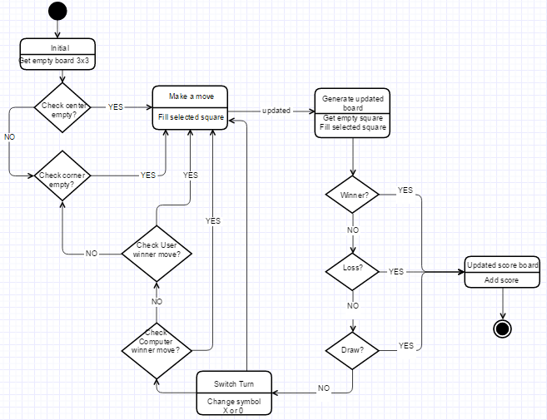
Heuristic approach in advanced level

Slide 7
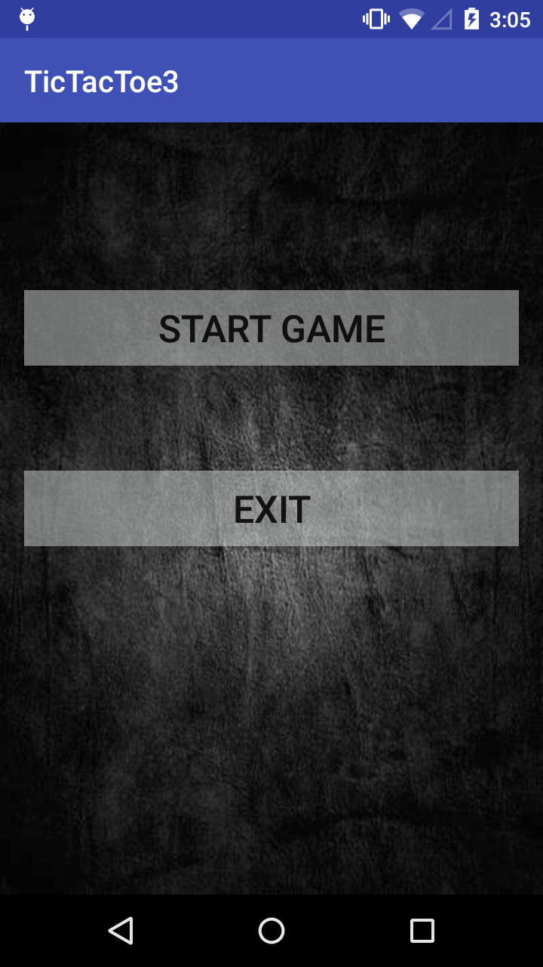
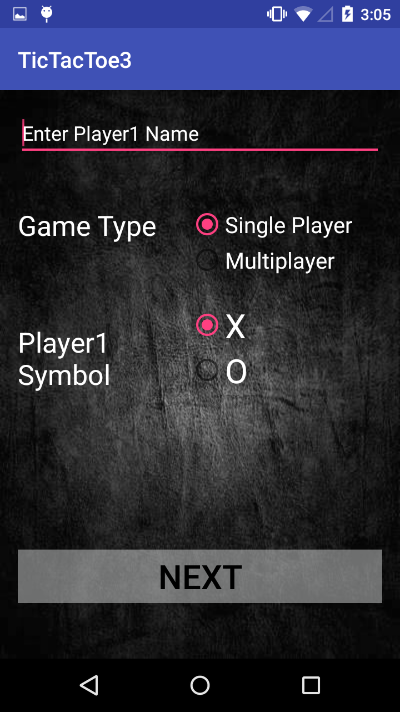
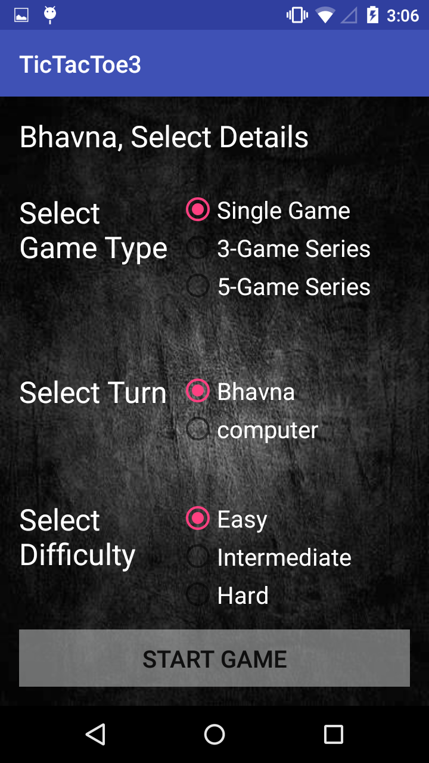
Screenshot: Tic-Tac-Toe

Slide 8
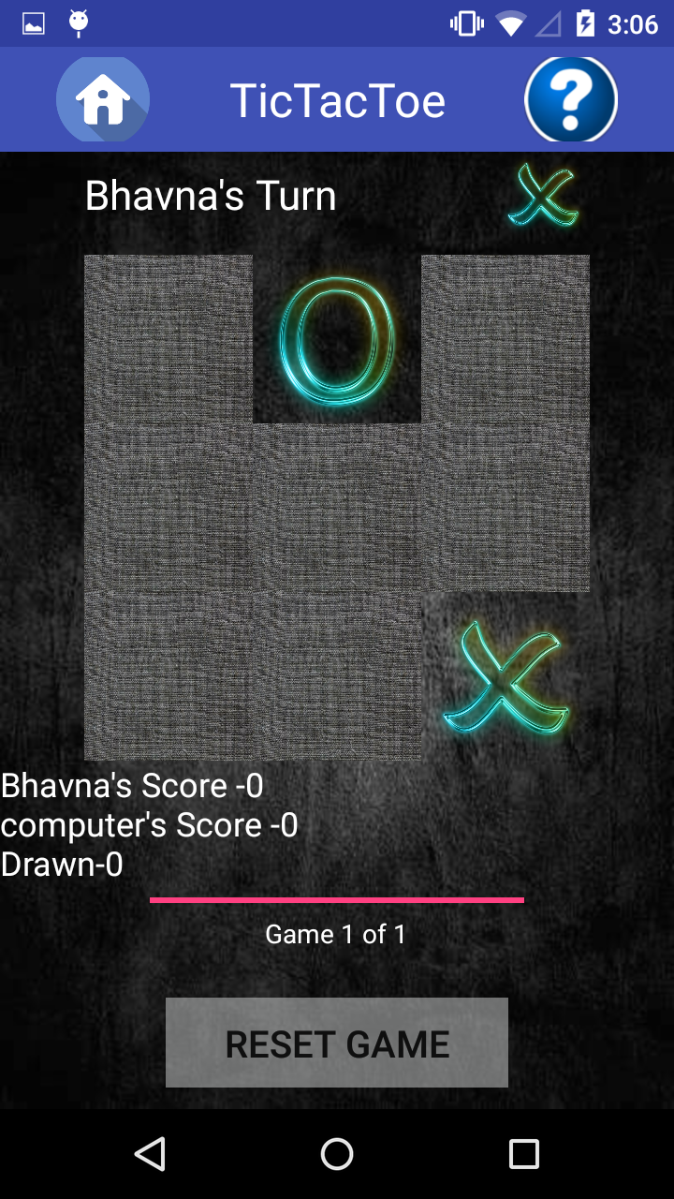
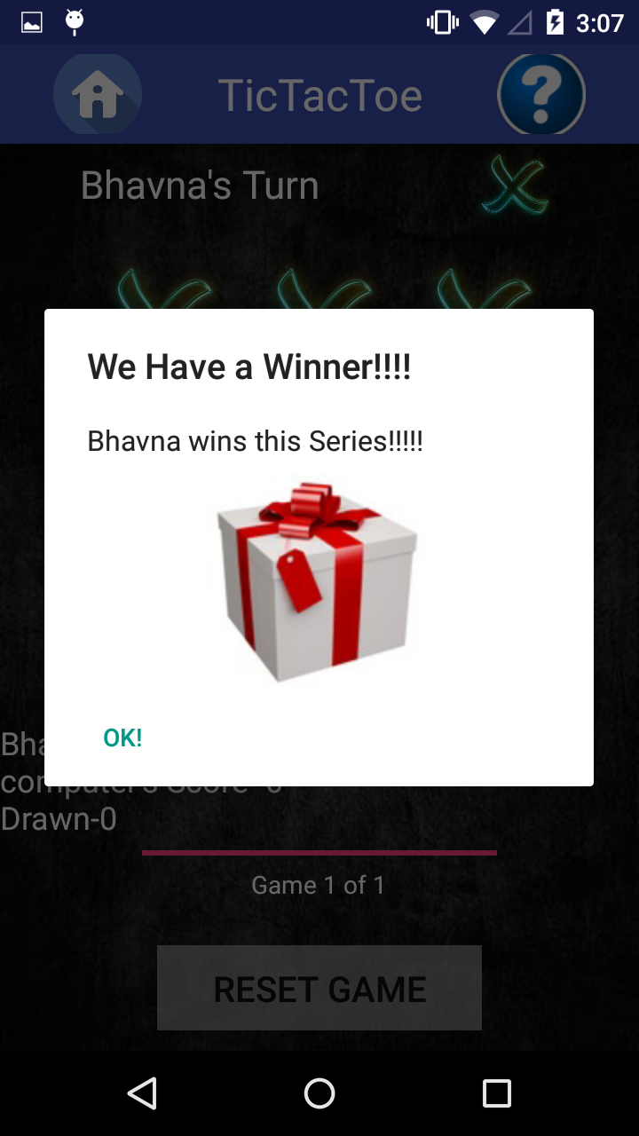
To be continued…

Slide 9
Thank You

